Slide 1

Aspiration
Jane C. Feagin
Tess Simons
2020

Slide 2
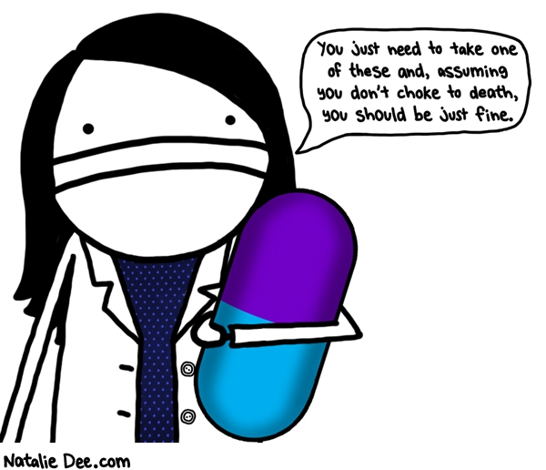
Notes:
You just need to take one of these and, assuming you don’t choke to death, you should be just fine.

Slide 3
Objectives
Pathophysiology of the respiratory tract
Definition of Aspiration in the Elderly
Causative factors for aspiration
Treatments for aspiration
Common health issues as a result of aspiration
Charting clues for aspiration

Slide 4
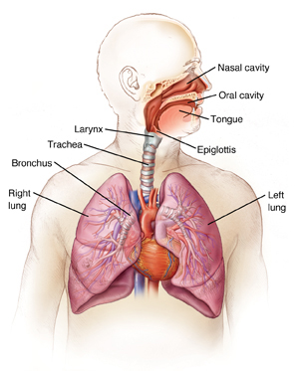
Notes:
Epiglottis- when swallowing its vital function is to prevent food and liquid from going down the trachea- like a trap door that is triggered by food.
Bronchial tree- trachea, right lung, left lung.
Your right lung is more susceptible to aspiration due to anatomy, a straighter shot in to the lung from the esophagus.

Slide 5
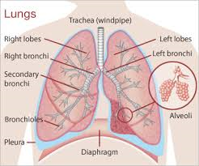
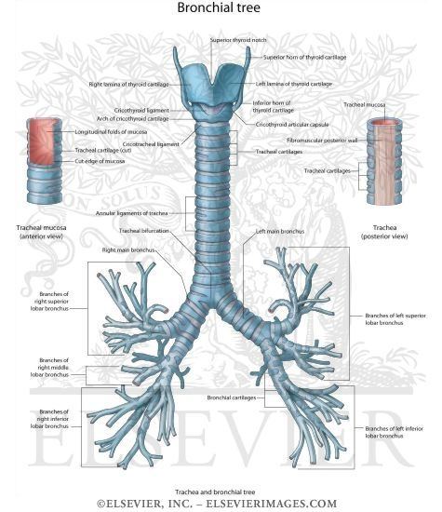

Slide 6
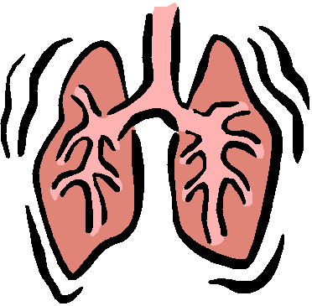
Aspiration
Occurs upon inhalation of oropharyngeal or gastric contents into the lower respiratory tract.
Notes:
Misdirection of oropharyngeal secretions or gastric contents into the larynx and lower respiratory tract.

Slide 7
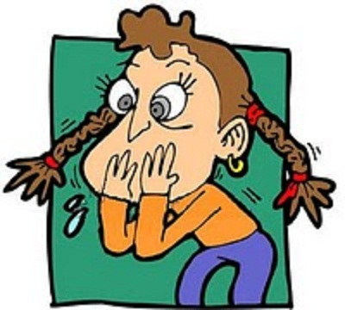

Causative Factors for Aspiration
Dysphagia
Poor oral hygiene
Use of certain medications
Esophageal disorders
Reduced levels of alertness
Feeding tube
Aging
Gastro esophageal Reflux disease
Heartburn
Anesthesia
Notes:
Dysphagia- difficulty swallowing
Medications- sedatives

Slide 8

High Risk Conditions for Aspiration
Lung Disease
Seizures
Stroke
Dental Problems
Needing assistance with eating
AGE
Parkinson’s Disease
Dementia
Notes:
Aspiration occurs in about 40-50% of stroke patients with dysphagia.
Conditions that suppress the cough reflex can further increase the risk of aspiration.
Affects both sexs, all races.
Also such instances as vomiting.

Slide 9
Symptoms of Aspiration
Choking
Shortness of Breath
Wheezing
Fatigue
Blue discoloration of skin
Cough
Fever
Difficulty swallowing
Excessive sweating
Decreased oxygen flow
Rapid heart rate
Crackling sounds in the lungs
Gradual weight loss

Slide 10
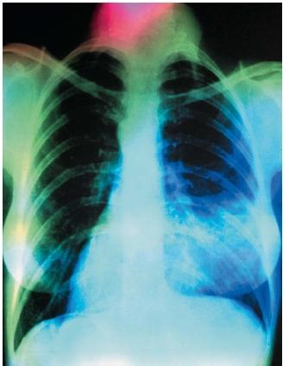
Diagnostics
Chest x-ray
Contrast CT Scan
Bronchoscopy
Notes:
Grouped with symptoms

Slide 11

Complications of Aspiration
Pneumonia
Abscess
Obstruction
pneumonia
Pneumonia typically occurs when the aspirated material contains bacteria and other microorganisms, precipitating an inflammatory reaction.
Notes:
Residents with dysphagia carry a sevenfold increased risk of aspiration pneumonia and is an independent predictor of mortality.

Slide 12
Just the facts…
In the LTC setting, aspiration pneumonia is the second most common cause of infection, hospital transfer, and mortality.*
It is also one of the most common causes for nursing home-acquired pneumonia.

Slide 13

More Facts…
Mortality associated with pneumonia in the LTC population has been studied and for that of 108 consecutive patients who acquired pneumonia in an LTC facility over the course of 1 year found mortality rates to be:
19% at 14 days
59% at 1 year
75% at 2 years
Notes:
Oh E, Weintraub N, Dhanani S. Can we prevent aspiration in the nursing home? J AM Med Dir Association, 2005, S76-S80

Slide 14
Treatment
Prevention!
Recognizing and promptly addressing risk factors is essential to protecting the health and wellbeing of our most vulnerable residents.
Antibiotics
Breathing inhalation treatments
Activity
Swallowing precautions

Slide 15

Precautions
Elevate the head of bed.
Checking gastric residual every 4-6 hours for continuous tube feeding residents.
Evaluate the residents swallowing
Inspect the residents mouth, their chewing ability
Small, frequent amount of food
Make sure the resident is fully alert

Slide 16

Documentation Clues
Nursing Notes/Assessments
Physician Orders
Dietary/Dietician Notes
Therapy Notes
Care Plans
MDS (Section K)
Hospitalization Protocols
Hospital Records
Notification Protocols
Survey Results
Notes:
Nursing Assessment this may be a form that is completed at the time of the residents admission. AND at the time of re-admisssion from the hospital.
Nursing Notes-These should be grouped chronologically. Weekly/ monthly summaries.
Dietary- narrative notes, food consumption sheets
Activities notes- any issues noted during an activity, did they follow swallowing precautions during birthday cake eating?
Therapy Notes: Speech therapy, Restorative Nursing notes.

Slide 17
Common Charting Mistakes
Failing to record pertinent health information.
Failing to record nursing actions.
Failing to record medications have been given
Recording on the wrong chart.
Failing to document discontinued treatments/medications.
Failing to record drug reactions or changes in patient conditions.
Transcribing order improperly.
Writing illegible or incomplete records.

Slide 18
Sources
Liantonio, J. MD, Salzman, B.MD, Snyderman, D. MD Preventing Aspiration Pneumonia by Addressing Three Key Risk Factors: Dysphagia, Poor Oral Hygiene, and Medication Use. Annals of Long Term Care, 2015.
Oh E, Weintraub N, Dhanani S. Can we prevent aspiration in the nursing home? J AM Med Dir Association, 2005, S76-S80
Demilliano, Marianne, BSN, 8 Common Charting Mistakes to Avoid. NSO-Nurses Service Organization
Obtained from web: www.sw.org/aspiration precautions
Obtained from web: https://nursinghomesa.nyhealth.gov

